Slide 1
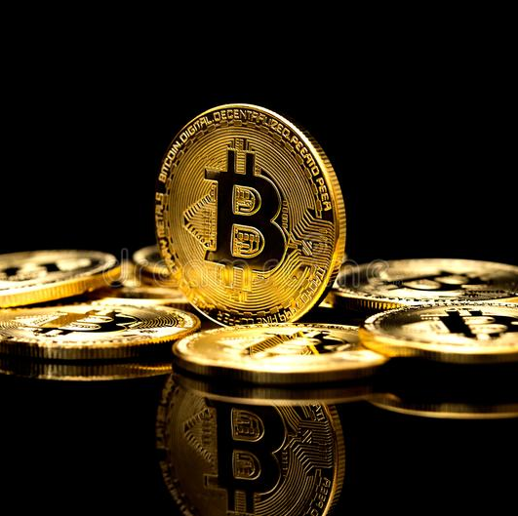
BITCOIN
Presented by Group - 03
1965 - Bushra Akter
1970 - Zannat Hosssain Tamim
1974 - Kazi Sati
1982 - Sanjida Akter
1984 - Mst.Sabina Yeasmim
1986 - Mst.Sanzida Islam Promi
1987 - Afroza Ahmed Srity

Slide 2

Introduction to Bitcoin
What is bitcoin?
Bitcoin (BTC) is a cryptocurrency, a virtual currency designed to act as money and a form of payment outside the control of any one person, group, or entity, thus removing the need for third-party involvement in financial transactions. It is rewarded to blockchain miners for the work done to verify transactions and can be purchased on several exchange.
History:
Bitcoin is software-based online payment system described by Satoshi Nakamoto in 2008. and introduced as open-source software in 2009. Payments are recorded in a public ledger using its own unit of account (Bitcoin). Bitcoin is commonly referred to as cryptocurrency and it can be divided into smaller unit called Satoshi (one hundred millions of a BTC).

Slide 3
Characteristics of bitcoin
1.Decentralization
No bank
No government
No capital limit
Account can’t block
2.Transparency
As we already mentioned every transaction is stored in a public ledger, the blockchain, this automatically means transparency. People who utilize this digital currency can remain anonymous; nobody can know personal or financial information, although transactions are all recorded on this ledger and are publicly available in the ecosystem. Users of the network must be incentivized to trust the network.

Slide 4
Characteristics of bitcoin(Cont.)
3. Open Sourced
Bitcoin is open-sourced. Bitcoin’s design is public, developers from the whole world can participate in the improvement and development of the network. Nobody owns or controls Bitcoin.
4. Fast, Easy & Safe(transaction)
One of the most important characteristics is the quick and safe process of transactions. Bitcoin has the possibility to send money across the globe with low transaction costs and just in a few seconds or minutes. Bitcoin is faster than any other method of transaction. It is important to mention that transactions are Peer-to-Peer or P2P, this means that no one-third party is needed to complete and verify the transactions. Then, users can make an address in the bitcoin network in just a few minutes. Users don’t need any legal documents (such as in banks), the only thing is to create a very strong password and it is important to remember it because it is not getting back!

Slide 5
Characteristics of bitcoin(Cont.)
5. Privacy
It is not important to mention again and again anonymity, due to the fact that there is no way to track everything about the user. There are no requirements of any legal paper that can help to identify the person. So, the government can’t know who is behind from every account.
6. Permissionless
It’s called “permissionless” because there are no gatekeepers and no censorship. Anyone who wants to access the blockchain does not need to pass Know Your Customer (KYC) requirements or provide identification documents.

Slide 6
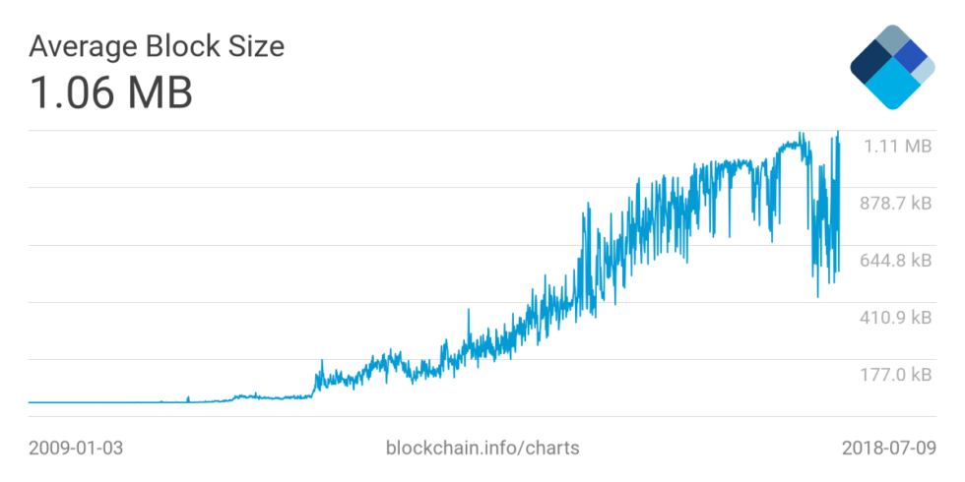
Size of Bitcoin
Bitcoin is highly volatile and constantly changing. The size of the blockchain is constantly increasing as more transactions are added to it, so the actual size may be larger now.
Bitcoin Blockchain Size is at a current level of 453.89, up from 453.55 yesterday and up from 389.95 one year ago.

Slide 7
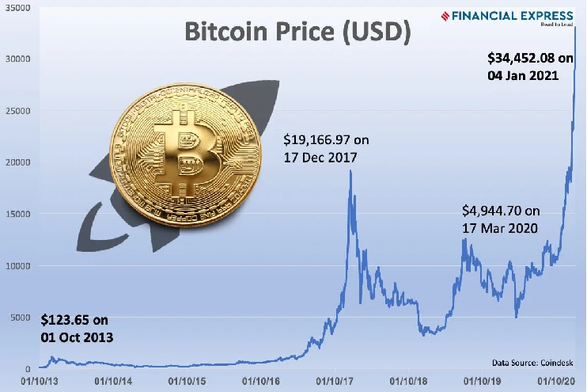
Price of Bitcoin
By checking any reputable cryptocurrency exchange, we can find the current price of Bitcoin .
The price of Bitcoin can fluctuate rapidly and is influenced by various factors such as supply and demand, market sentiment, global events, and regulatory developments.

Slide 8
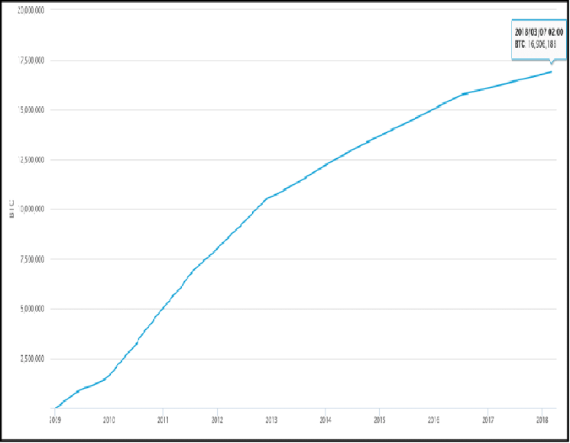
Total number of Bitcoin
There are currently 21 million bitcoins that have been programmed to be created, with roughly 18.8 million already in circulation.

Slide 9
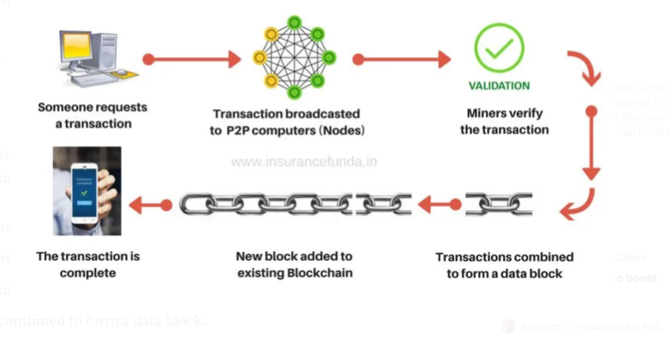
Transaction of Bitcoin

Slide 10
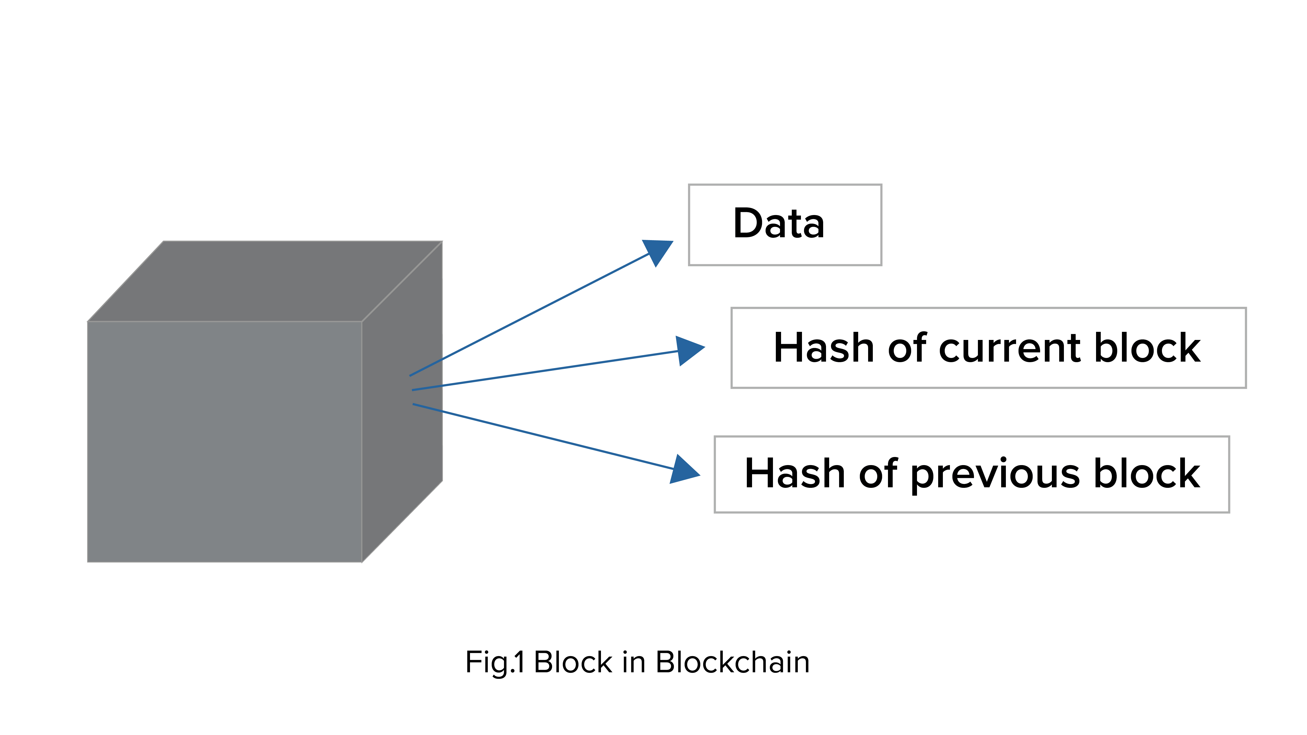
Blockchain
Data
Nonce
Transaction information
Hash value
Hash of previous block
A block

Slide 11
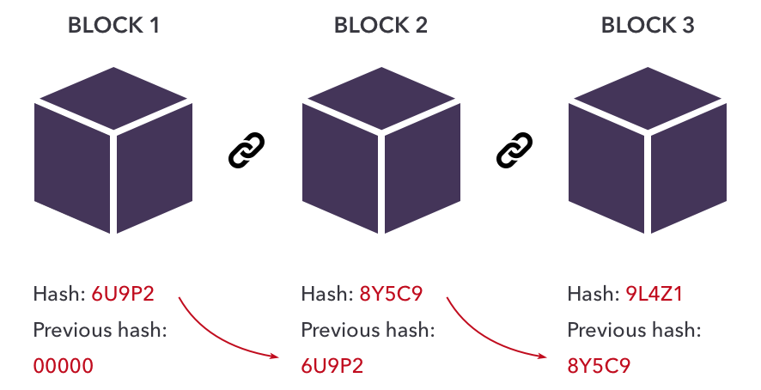
Blockchain
The nonce, a 32-bit number, is randomly generated when a block is created.
This nonce generates a header hash.
Hash is a 256-bit number wedded to the nonce. Bitcoin technology uses sha256 hash to generate the hash.
When the ﬁrst block of a chain is created, a nonce generates the cryptographic hash.

Slide 12

The Miners
Miners use special software to solve math problems (Bitcoin algorithm), and upon completing the task they receive certain amount of coins.
The mining process of Bitcoin involves Proof-of-work which means that the miners need to ﬁnd hash which can solve the arithmetic puzzle.
Miners needs to find the nonce, a string of numbers. This number is appended to the hashed contents of the previous block which is then hashed

Slide 13
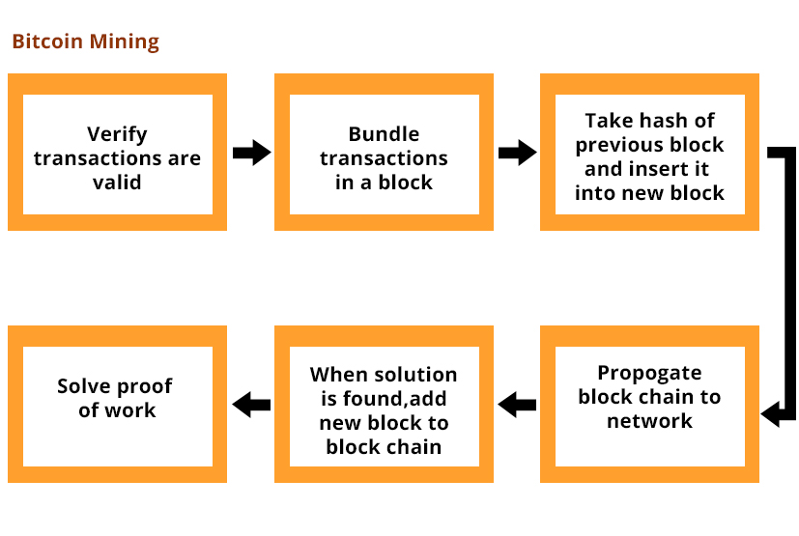
Mining process of Bitcoin

Slide 14
Halving
Miners are rewarded with Bitcoin for verifying blocks of transactions.
reward is cut in half every 210,000 blocks mined, every four year.
Rewards for Bitcoin mining will continue until about 2140

Slide 15
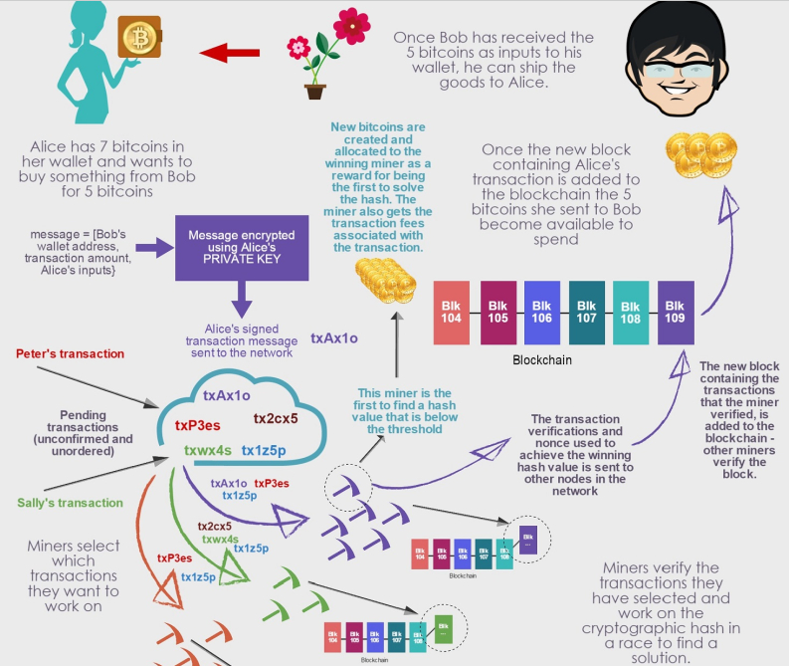
Overall
Transaction Process

Slide 16
Security Issues
1. Double spending attack
2. Finney attack
3. Brute force attack
4. Vector 76 / one-confirmation attack
5. Goldfinger attack
6. Block discarding / selfish mining

Slide 17
Security Issues(Cont.)
Double spending attack: double spending attack occurs when the same set of bitcoins are spent in two different transactions.
Finney Attack: The Finney attack is a form of double spending attack in which a dishonest client pre-mines a block containing a transaction paying the coins to an address under their control.
Brute Force Attack: A brute force attack is a method of attempting to crack a password or decrypt data simply by guessing every possible password or decryption key. Brute force is highly inefficient, so a brute force attack is usually used as a last resort against a system which is impervious to other, more efficient attack methods.

Slide 18
Security Issues(Cont.)
Vector 76 / one-confirmation attack: Vector Attack 76 is a type of double-spend attack that exploits a small bug in the Bitcoin consensus system to launch. As a result, an attacker can steal funds and cause damage to their victims.
Others Attack:
Block withholding
Block withholding attack is an action where a miner who has found a legal block chooses not to submit it but rather directly abandons it. This attack makes the mining pool lose all bitcoin rewards contained within the block.
Goldfinger attack
This is known as a 51% attack (it enables you to double spend at will for example). When the motivation is not to profit directly through Bitcoin, but instead to bring down the currency or network, it is called a Goldfinger attack.

Slide 19
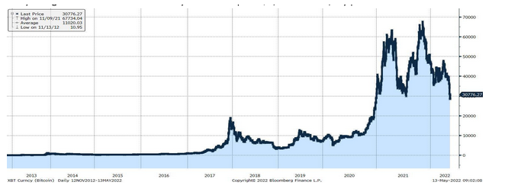
Challenges of Bitcoin
(1)Unstable value
Bitcoin is an unreliable store of value. Bitcoin’s value routinely changes daily by 1-3%, which can be substantial when seen over a month or a year. For further clearance, See the chart :
After hitting a high of $1,150 in November 2013, the price of one Bitcoin dropped to $500 by mid-December and didn’t recover for four years.
It touched $19,000 in late 2017, only to drop 83%, back to $3,200 twelve months later.
In April 2021, it reached $63,000 and bottomed at $29,000 in July
In November 2021, it peaked at $67,000 and now sits around $31,000

Slide 20
Challenges of Bitcoin(Cont.)
(2)Slow processing speed
Processing speed is another drawback. The processing is slow to protect the security of the blockchain technology that makes digital currency so secure. As a result, there are practical limits on the number of daily transactions, causing even simple transactions to take days. As users increase, so too will wait times. One large credit card company processes close to 150 million transactions per day, or about 1,700 per second, with more capacity available. On the contrary, Blockchain networks process about seven transactions per second. The slow processing speed of digital currency transactions is a significant roadblock to scalability. And Bitcoin is slower than others.
(3)Transaction fees are too high
Transaction fees were not part of the original system. As Bitcoin has grown over the last decade, users must wait longer to add their transactions to the blockchain. Transaction fees arose as an incentive mechanism to allow users to move to the head of the line.

Slide 21
Challenges of Bitcoin(Cont.)
(4)Cybertheft
Several guidelines exist to make BTC almost impossible to steal, but taking advantage of this system requires intricate knowledge about bitcoin’s working system and significantly more effort on the part of the user. In fact, many reports suggest that buyers lose their investments on exchanges and mining losses. Also, exchanges can be hacked despite the presence of a smart wallet. (5)Tax issues
Presently, under the law, BTC is considered as intangible property, which means they are subjected to capital gains taxes. If the investors buy bitcoin and sell it at a higher price, they will be required to show the difference in their taxes. Every time the investors buy something with BTC, it will be a taxable event. (6)Reputation for criminal use
In the early days, bitcoin was well known on the Dark Web for money-laundering activities, or to purchase illegal items. As the only source of anonymous payment, bitcoin became an easy choice for people dealing with drugs, illegal weapons, and other related items.

Slide 22
Legal & Regulatory Issues Related to Bitcoin
The legality of Bitcoin varies by country and jurisdiction. While some countries have fully embraced Bitcoin and other cryptocurrencies, others have imposed strict regulations or outright bans on their use.
In general, most developed countries allow the use of Bitcoin, but regulations and laws vary. For example, the United States and Canada have relatively permissive laws, but there are still regulations around taxation, securities laws, and anti-money laundering (AML) and know-your-customer (KYC) requirements.
In some countries, such as Japan and Australia, Bitcoin is fully legal and recognized as a form of payment. In others, such as Germany, Bitcoin is considered a financial instrument subject to regulatory oversight.

Slide 23
Legal & Regulatory Issues Related to Bitcoin (Cont.)
However, there are some countries where Bitcoin is illegal or restricted. For example, China has banned Bitcoin and other cryptocurrencies, and India has proposed a ban on all cryptocurrencies. In some countries, such as Egypt and Algeria, Bitcoin is not officially illegal but is highly discouraged or restricted by the government.
It is important to note that the legal status of Bitcoin and other cryptocurrencies is constantly evolving, and it is important to stay up to date on the laws and regulations in your jurisdiction if you plan to use or invest in Bitcoin.

Slide 24
Advantages of Bitcoins
1. Protection From Payment Fraud
Bitcoins are digital currencies. It uses an algorithm and cryptographic protocols. This makes them impossible to counterfeit.
2. Immediate Settlement
Bitcoin does not involve a third party to facilitate the transactions. Funds are settled immediately and once initiated cannot be put on hold or can be refunded.
3. Direct Transfer
Transactions directly take place between users that is the sender and receiver. No third party involved there.
4. Security
Bitcoin has very strong security and it is impossible to counterfeit or cheat the bitcoin payment network.

Slide 25
Advantages of Bitcoins(Cont.)
5. Greater Liquidity
While converting to other real-world currencies bitcoin retains most of it values while other cryptocurrencies lost their value.
6. International Transactions.
Bitcoin is the easiest method to initiate an international transaction. It does not charge any extra fees and settle immediately to a receiver.
7. Independent
Any political or governing authority does not regulate Bitcoin. It does not have political influence. Neither government nor any authority can freeze it or seize it.
8. Blockchain
Bitcoin transactions are tamperproof thanks to Blockchain.

Slide 26
Disadvantages of Bitcoins
1. Scams and frauds
Bitcoin is technically difficult and not easy to understand for a common citizen. Fake websites and apps are selling bitcoin and faking people.
2. Black market activity
Bitcoin is popular in the black market and criminals. Due to the complete anonymous feature, bitcoin is used in cyber hacking, drug deals, and black-market arms deals.
3. Price volatility
After the FBI declared that, it would treat bitcoin as other legitimate financial services, bitcoin value skyrocketed. When a security breach happened in MT. Gox bitcoin exchange, bitcoin value fall more than 50 percent. This price volatility makes bitcoin investment difficult.

Slide 27
Disadvantages of Bitcoins(Cont.)
4. No refund.
Once payment is initiated and complete bitcoin cannot be held and refunded. It takes place directly between users and without an intermediator. So bitcoin cannot be transferred back.
5. Future Cryptocurrencies.
Bitcoin may be replaced by some other future cryptocurrency, which can address the disadvantage of bitcoin while retaining a superior secure network.
6. Cyber hacking
Hacking and illegal ransomware use bitcoin as a payment system to extort money from affected victims. This makes them untraceable due to bitcoins anonymous nature.
7. Piracy
Pirated file-sharing services rely on bitcoins to run their networks.

Slide 28
Future of Bitcoin
The future of Bitcoin is uncertain and subject to a range of potential outcomes, including -
increased adoption and use
greater regulatory oversight,
continued price volatility
increased competition
technological advancements
However, it is likely that Bitcoin will continue to play a significant role in the global financial system in the coming years.

Slide 29

Thank You

